Slide 1
Chapter #1
Data Mining: Introduction
by
Tan, Steinbach, Kumar
Compiled by G Murtaza Memon

Slide 2



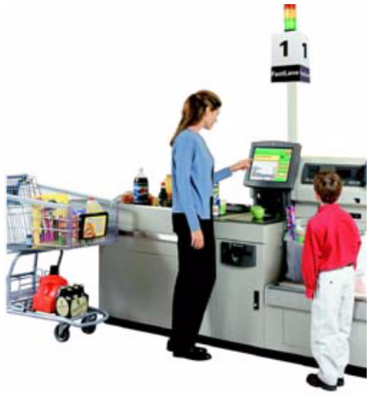
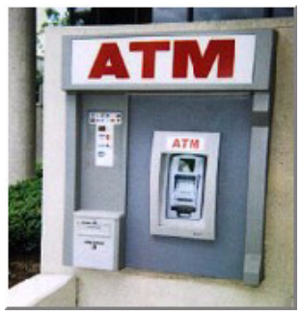
Why Mine Data? Commercial Viewpoint
Lots of data is being collected
and warehoused
  Web data, e-commerce
  purchases at department/
  grocery stores
  Bank/Credit Card
  transactions
Computers have become cheaper and more powerful
Competitive Pressure is Strong
  Provide better, customized services for an edge (e.g. in Customer Relationship Management)
Compiled by G Murtaza Memon

Slide 3
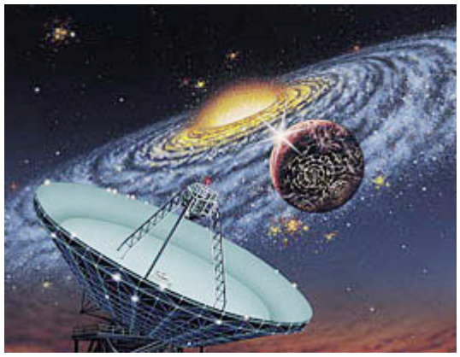
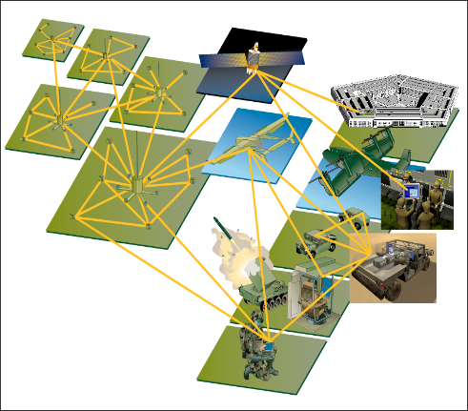
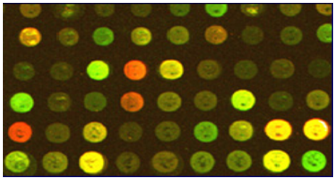
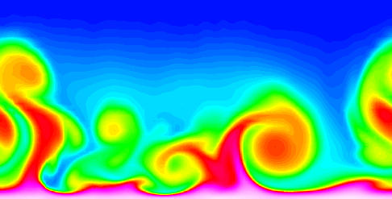
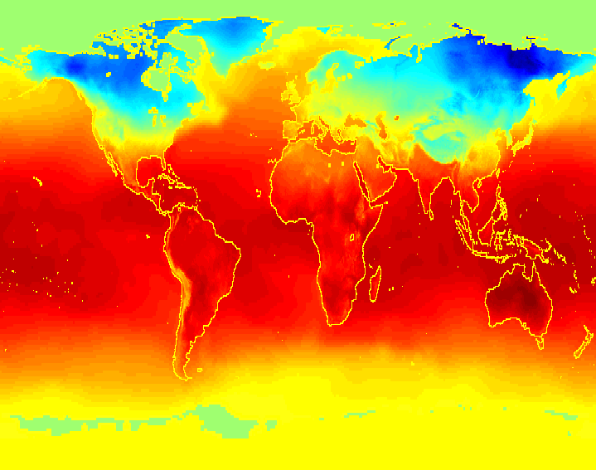
Why Mine Data? Scientific Viewpoint
Data collected and stored at
enormous speeds (GB/hour)
  remote sensors on a satellite
  telescopes scanning the skies
  microarrays generating gene
  expression data
  scientific simulations
  generating terabytes of data
Traditional techniques infeasible for raw data
Data mining may help scientists
  in classifying and segmenting data
  in Hypothesis Formation
Compiled by G Murtaza Memon

Slide 4
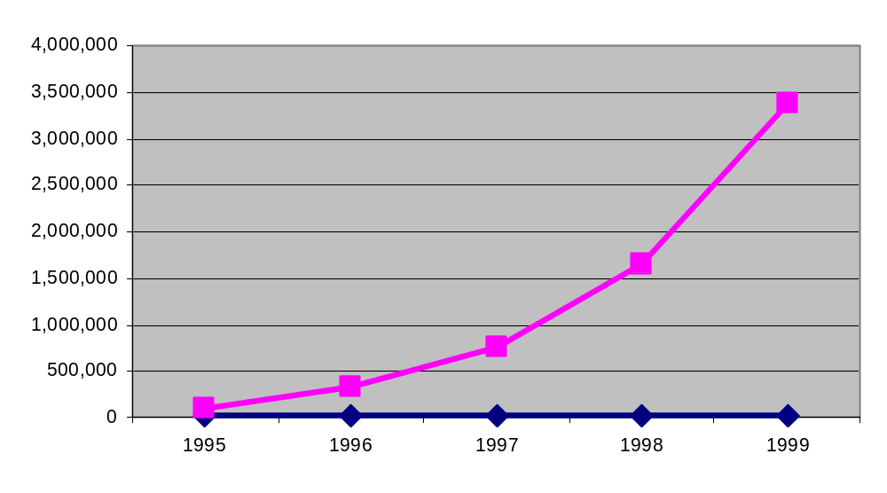
Mining Large Data Sets - Motivation
There is often information “hidden” in the data that is
not readily evident
Human analysts may take weeks to discover useful information
Much of the data is never analyzed at all
The Data Gap
Total new disk (TB) since 1995
Number of analysts
Compiled by G Murtaza Memon

Slide 5
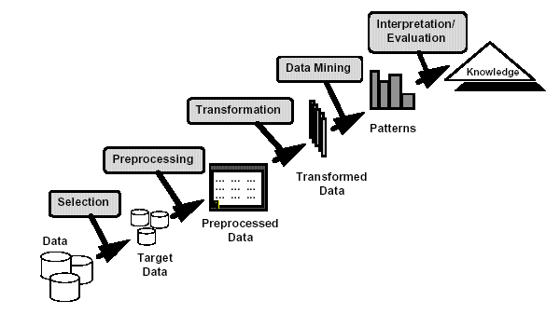
What is Data Mining?
Many Definitions
  Non-trivial extraction of implicit, previously unknown and potentially useful information from data
  Exploration & analysis, by automatic or
  semi-automatic means, of
  large quantities of data
  in order to discover
  meaningful patterns
Compiled by G Murtaza Memon

Slide 6
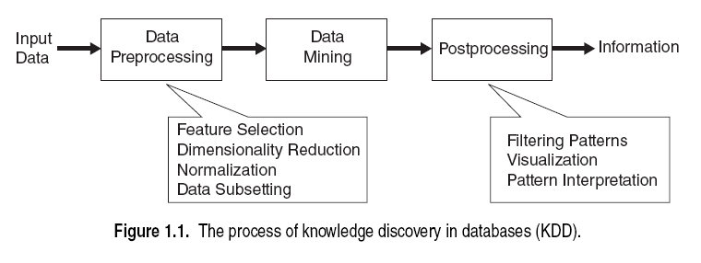
KDD Process
Data mining is integral part of Knowledge discovery in databases(KDD).
It’s the overall process to convert raw data into useful information.
Pre-porcessing: Transforms data in form to become ready for analysis for particular objective.
In-processing(DM Process): extracts patterns, rules or associations.
Pot-processing: Filters ,visualize and interpretation of patterns
Compiled by G Murtaza Memon

Slide 7
What is (not) Data Mining?
What is not Data Mining?
  Look up phone number in phone directory
  Query a Web search engine for information about “Amazon”
What is Data Mining?
  Certain names are more prevalent in certain US locations (O’Brien, O’Rurke, O’Reilly… in Boston area)
  Group together similar documents returned by search engine according to their context (e.g. Amazon rainforest, Amazon.com,)
Compiled by G Murtaza Memon

Slide 8
Origins of Data Mining
Draws ideas from machine learning/AI, pattern recognition, statistics, and database systems
Traditional Techniques
may be unsuitable due to
  Enormity of data
  High dimensionality
  of data
  Heterogeneous,
  distributed nature
  of data
Statistics/
AI
Machine Learning/
Pattern
Recognition
Data Mining
Database systems
Compiled by G Murtaza Memon

Slide 9
Data Mining Tasks
Prediction tasks/Methods (Future prediction)
  Use some variables to predict unknown or future values of other variables.
      The attributed to be predicted are commonly known as target or dependent variables
      The attributes to be used for making prediction are known as the explanatory or independent variables.
Description tasks/Methods (Past Exploration)
  Objective is to derive patterns, rules(correlation, trends, clusters, trajectories and anomalies) to summarize the underlying relationships in data
  Find human-interpretable patterns that describe the data.
Compiled by G Murtaza Memon

Slide 10
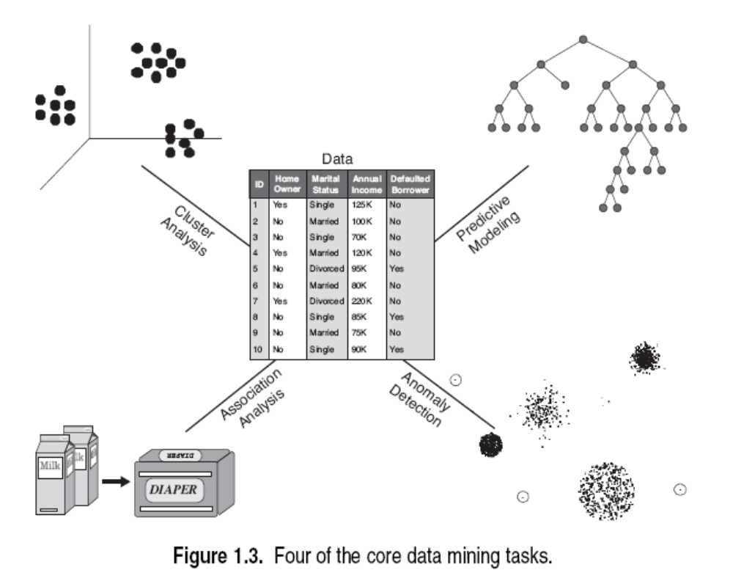
DM Tasks
Compiled by G Murtaza Memon

Slide 11
Predictive modeling
Task of building a model for the target variable as a function of the explanatory variables.
Two type of predictive modeling tasks
  Classification
  Regression
Classification: Used for discrete target variables.
      E.g predicting weather a particular user will buy online book or not.
      It’s a binary valued attribute like yes,no or good, bad or etc.
Regression: used for continuous(numeric) target variables.
      Example: Forecasting the future price of a stock is a numeric valued attribute.
The goal of both modeling techniques is to minimize the error between the predicted and the true values of the target variable.
It can identify/predict
  The customers that will respond to a marketing campaign
  The disturbance in the earths ecosystem
  Patient has particular disease based medical tests.
Compiled by G Murtaza Memon

Slide 12
Data Mining Tasks...
Classification [Predictive]
Clustering [Descriptive]
Association Rule Discovery [Descriptive]
Sequential Pattern Discovery [Descriptive]
Regression [Predictive]
Deviation Detection [Predictive]
Compiled by G Murtaza Memon

Slide 13
Classification: Definition
Given a collection of records (training set )
  Each record contains a set of attributes, one of the attributes is the class.
Find a model for class attribute as a function of the values of other attributes.
Goal: previously unseen records should be assigned a class as accurately as possible.
  A test set is used to determine the accuracy of the model. Usually, the given data set is divided into training and test sets, with training set used to build the model and test set used to validate it.
Compiled by G Murtaza Memon

Slide 14


Classification Example
categorical
categorical
continuous
class
Test
Set
Learn
Classifier
Training
Set
Model
Compiled by G Murtaza Memon

Slide 15
Classification: Application 1
Direct Marketing
  Goal: Reduce cost of mailing by targeting a set of consumers likely to buy a new cell-phone product.
  Approach:
    Use the data for a similar product introduced before.
    We know which customers decided to buy and which decided otherwise. This {buy, don’t buy} decision forms the class attribute.
    Collect various demographic, lifestyle, and company-interaction related information about all such customers.
      Type of business, where they stay, how much they earn, etc.
    Use this information as input attributes to learn a classifier model.
From [Berry & Linoff] Data Mining Techniques, 1997
Compiled by G Murtaza Memon

Slide 16
Classification: Application 2
Fraud Detection
  Goal: Predict fraudulent cases in credit card transactions.
  Approach:
    Use credit card transactions and the information on its account-holder as attributes.
      When does a customer buy, what does he buy, how often he pays on time, etc
    Label past transactions as fraud or fair transactions. This forms the class attribute.
    Learn a model for the class of the transactions.
    Use this model to detect fraud by observing credit card transactions on an account.
Compiled by G Murtaza Memon

Slide 17
Classification: Application 3
Customer Attrition/Churn:
  Goal: To predict whether a customer is likely to be lost to a competitor.
  Approach:
    Use detailed record of transactions with each of the past and present customers, to find attributes.
      How often the customer calls, where he calls, what time-of-the day he calls most, his financial status, marital status, etc.
    Label the customers as loyal or disloyal.
    Find a model for loyalty.
From [Berry & Linoff] Data Mining Techniques, 1997
Compiled by G Murtaza Memon

Slide 18
Classification: Application 4
Sky Survey Cataloging
  Goal: To predict class (star or galaxy) of sky objects, especially visually faint ones, based on the telescopic survey images (from Palomar Observatory).
      3000 images with 23,040 x 23,040 pixels per image.
  Approach:
    Segment the image.
    Measure image attributes (features) - 40 of them per object.
    Model the class based on these features.
    Success Story: Could find 16 new high red-shift quasars, some of the farthest objects that are difficult to find!
From [Fayyad, et.al.] Advances in Knowledge Discovery and Data Mining, 1996
Compiled by G Murtaza Memon

Slide 19



Classifying Galaxies
Courtesy: http://aps.umn.edu
Early
Class:
Stages of Formation
Attributes:
Image features,
Characteristics of light waves received, etc.
Intermediate
Late
Data Size:
72 million stars, 20 million galaxies
Object Catalog: 9 GB
Image Database: 150 GB
Compiled by G Murtaza Memon

Slide 20
Data Mining Tasks...
Classification [Predictive]
Clustering [Descriptive]
Association Rule Discovery [Descriptive]
Sequential Pattern Discovery [Descriptive]
Regression [Predictive]
Deviation Detection [Predictive]
Compiled by G Murtaza Memon

Slide 21
Clustering Definition
Given a set of data points, each having a set of attributes, and a similarity measure among them, find clusters such that
  Data points in one cluster are more similar to one another.
  Data points in separate clusters are less similar to one another.
Similarity Measures:
  Euclidean Distance if attributes are continuous.
  Other Problem-specific Measures.
Compiled by G Murtaza Memon

Slide 22
Illustrating Clustering
Euclidean Distance Based Clustering in 3-D space.
Intracluster distances
are minimized
Intercluster distances
are maximized
Compiled by G Murtaza Memon

Slide 23
Clustering: Application 1
Market Segmentation:
  Goal: subdivide a market into distinct subsets of customers where any subset may conceivably be selected as a market target to be reached with a distinct marketing mix.
  Approach:
    Collect different attributes of customers based on their geographical and lifestyle related information.
    Find clusters of similar customers.
    Measure the clustering quality by observing buying patterns of customers in same cluster vs. those from different clusters.
Compiled by G Murtaza Memon

Slide 24
Clustering: Application 2
Document Clustering:
  Goal: To find groups of documents that are similar to each other based on the important terms appearing in them.
  Approach: To identify frequently occurring terms in each document. Form a similarity measure based on the frequencies of different terms. Use it to cluster.
  Gain: Information Retrieval can utilize the clusters to relate a new document or search term to clustered documents.
Compiled by G Murtaza Memon

Slide 25
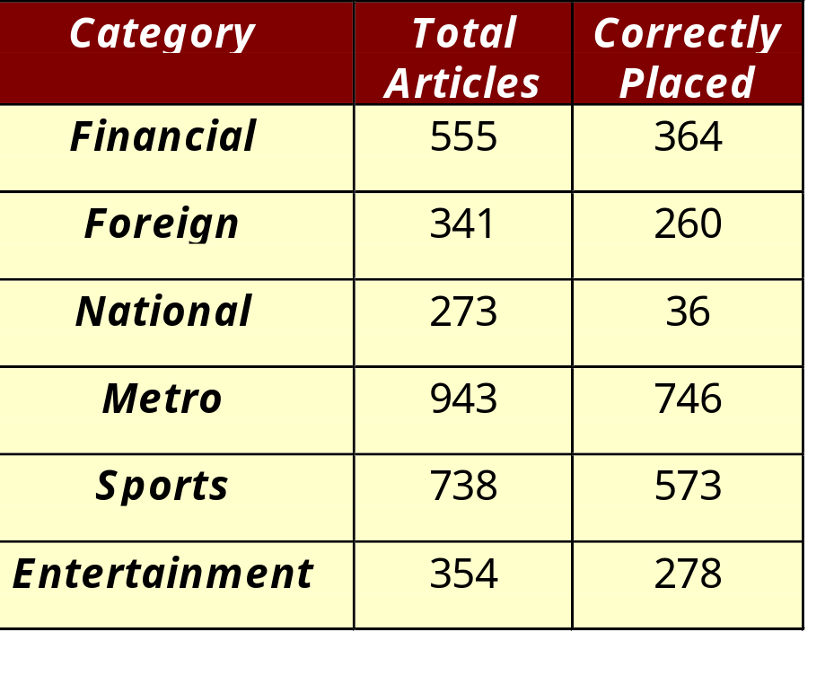
Illustrating Document Clustering
Clustering Points: 3204 Articles of Los Angeles Times.
Similarity Measure: How many words are common in these documents (after some word filtering).
Compiled by G Murtaza Memon

Slide 26
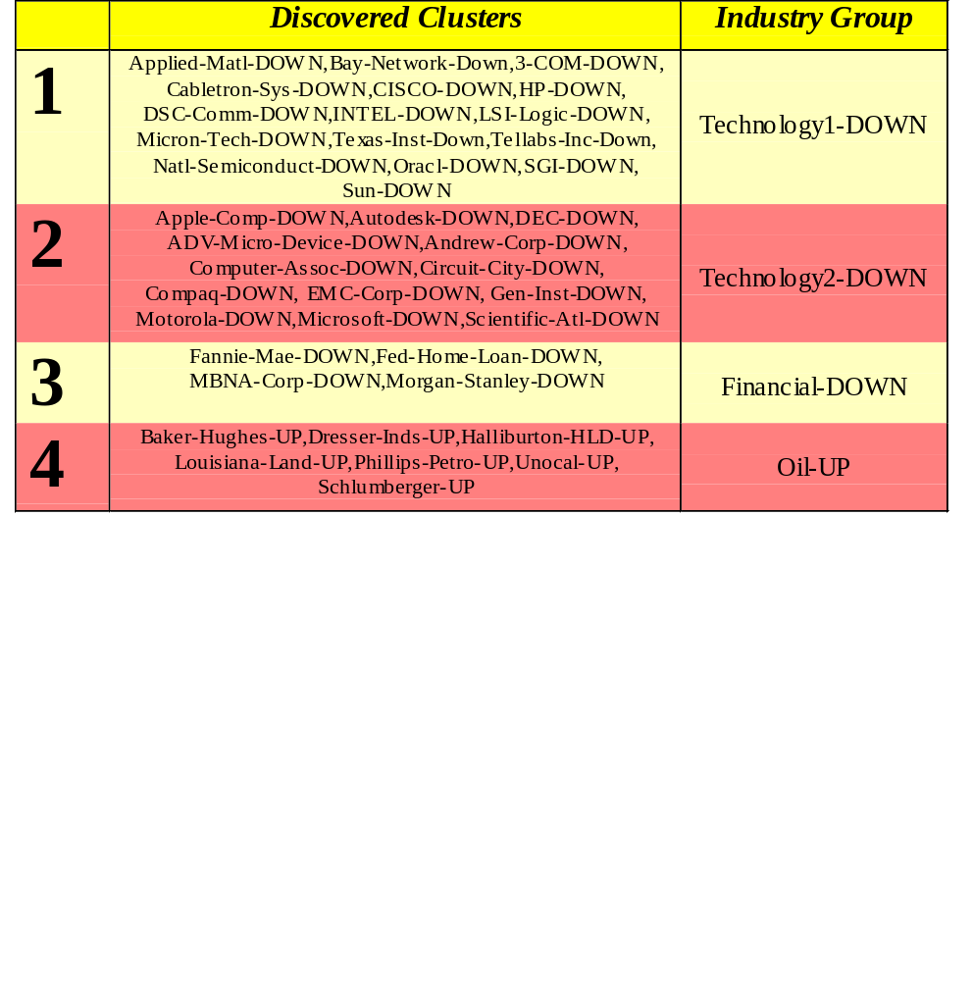
Clustering of S&P 500 Stock Data
Observe Stock Movements every day.
Clustering points: Stock-{UP/DOWN}
Similarity Measure: Two points are more similar if the events described by them frequently happen together on the same day.
  We used association rules to quantify a similarity measure.
Compiled by G Murtaza Memon

Slide 27
Data Mining Tasks...
Classification [Predictive]
Clustering [Descriptive]
Association Rule Discovery [Descriptive]
Sequential Pattern Discovery [Descriptive]
Regression [Predictive]
Deviation Detection [Predictive]
Compiled by G Murtaza Memon

Slide 28

Association Rule Discovery: Definition
Given a set of records each of which contain some number of items from a given collection;
  Produce dependency rules which will predict occurrence of an item based on occurrences of other items.
Rules Discovered:
{Milk} --> {Coke}
{Diaper, Milk} --> {Beer}
Compiled by G Murtaza Memon

Slide 29
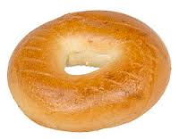
Association Rule Discovery: Application 1
Marketing and Sales Promotion:
  Let the rule discovered be
  {Bagels, … } --> {Potato Chips}
  Potato Chips as consequent => Can be used to determine what should be done to boost its sales.
  Bagels in the antecedent => Can be used to see which products would be affected if the store discontinues selling bagels.
  Bagels in antecedent and Potato chips in consequent => Can be used to see what products should be sold with Bagels to promote sale of Potato chips!
Compiled by G Murtaza Memon

Slide 30
Association Rule Discovery: Application 2
Supermarket shelf management.
  Goal: To identify items that are bought together by sufficiently many customers.
  Approach: Process the point-of-sale data collected with barcode scanners to find dependencies among items.
  A classic rule --
    If a customer buys diaper and milk, then he is very likely to buy beer.
    So, don’t be surprised if you find six-packs stacked next to diapers!
Compiled by G Murtaza Memon

Slide 31
Association Rule Discovery: Application 3
Inventory Management:
  Goal: A consumer appliance repair company wants to anticipate the nature of repairs on its consumer products and keep the service vehicles equipped with right parts to reduce on number of visits to consumer households.
  Approach: Process the data on tools and parts required in previous repairs at different consumer locations and discover the co-occurrence patterns.
Compiled by G Murtaza Memon

Slide 32
Data Mining Tasks...
Classification [Predictive]
Clustering [Descriptive]
Association Rule Discovery [Descriptive]
Sequential Pattern Discovery [Descriptive]
Regression [Predictive]
Deviation Detection [Predictive]
Compiled by G Murtaza Memon

Slide 33
Sequential Pattern Discovery: Definition
Given is a set of objects, with each object associated with its own timeline of events, find rules that predict strong sequential dependencies among different events.
Rules are formed by first discovering patterns. Event occurrences in the patterns are governed by timing constraints.
(A B) (C) (D E)
(A B) (C) (D E)
Compiled by G Murtaza Memon

Slide 34
Sequential Pattern Discovery: Examples
In telecommunications alarm logs,
  (Inverter_Problem Excessive_Line_Current)
  (Rectifier_Alarm) --> (Fire_Alarm)
In point-of-sale transaction sequences,
  Computer Bookstore:
  (Intro_To_Visual_C) (C++_Primer) --> (Perl_for_dummies,Tcl_Tk)
  Athletic Apparel Store:
  (Shoes) (Racket, Racketball) --> (Sports_Jacket)
Compiled by G Murtaza Memon

Slide 35
Data Mining Tasks...
Classification [Predictive]
Clustering [Descriptive]
Association Rule Discovery [Descriptive]
Sequential Pattern Discovery [Descriptive]
Regression [Predictive]
Deviation Detection [Predictive]
Compiled by G Murtaza Memon

Slide 36
5-Regression
Predict a value of a given continuous valued variable based on the values of other variables, assuming a linear or nonlinear model of dependency.
Greatly studied in statistics, neural network fields.
Examples:
  Predicting sales amounts of new product based on advertising expenditure.
  Predicting wind velocities as a function of temperature, humidity, air pressure, etc.
  Time series prediction of stock market indices.
Compiled by G Murtaza Memon

Slide 37

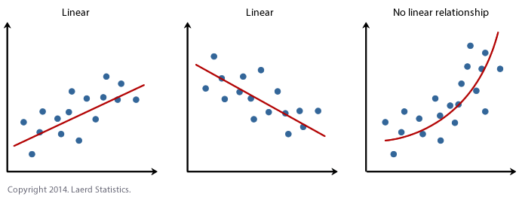
Compiled by G Murtaza Memon

Slide 38





6-Deviation/Anomaly Detection
Detect significant deviations from normal behavior
Applications:
  Credit Card Fraud Detection
  Network Intrusion
  Detection
Typical network traffic at University level may reach over 100 million connections per day
Compiled by G Murtaza Memon

Slide 39
Dataset
a collection of related sets of information that is composed of separate elements but can be manipulated as a unit by a computer.
  Same attributes
  But different rows
Compiled by G Murtaza Memon

Slide 40
Challenges of Data Mining
Scalability:
Dimensionality
Complex and Heterogeneous Data
Data Quality
Data Ownership and Distribution
Privacy Preservation
Streaming Data
Compiled by G Murtaza Memon

Slide 41
Challenges of Data Mining
Scalability:
      Managing large and rapidly increasing volumes of data is a challenging issue. Traditional software tools are not enough for managing the increasing volumes of data.
      Data mining algorithm must be scalable to handle large amount data.
      Implementation of novel data structures to access each record efficiently.
      Algorithms needed for processing datasets that can not fit into memory.
      Scalable by data sampling, developing parallel or distributed algorithms
Compiled by G Murtaza Memon

Slide 42
Challenges of Data Mining
Dimensionality
      Today data sets with hundreds or thousands of attributes unlike few decades before.
      Traditional techniques were developed for low dimensional data can not handle such kind of high dimensionality
      Also some Data analysis algorithms complexity increases as dimensionality increases.
Compiled by G Murtaza Memon

Slide 43
Challenges of Data Mining
Complex and Heterogeneous Data
      Tradition data analysis, methods deal attributes of same type either continuous or categorical.
      Due to vast DM role various fields like in business, science, medicine and etc
      Heterogeneous data attributes involved in DM process like
        Web pages contain semi structured text and hyperlinks
        DNA contains sequential and 3-D structures
        Climate data with time series measurements like temperature, pressure etc.
Compiled by G Murtaza Memon

Slide 44
Challenges of Data Mining
Data Ownership and Distribution
      Data may be geographically distributed
      No single owner
      This needs Distributed DM techniques/Algorithm
      Key challenges
        To reduce amount of communication
        Effective consolidation of DM distributed computation
        Data security issues.
Compiled by G Murtaza Memon

Slide 45
Challenges of Data Mining
Non-traditional analysis
      Based on hypothesized-and –test paradigm
      A hypothesis is proposed initially
      Experiment is designed to collect the data
      Then data is analyzed according to hypothesis
      Its an laborious job
      Now DM is used to create thousands of hypothesis and evaluations.
      Second data is not carefully/optimistically collected but random samples are used
      DM uses non-traditional data type. It can be unstructured ( images, videos, blogs, tweets, sensors data) or semi-structured(web logs, email, web pages) instead of only structured(RDBMS, OLAP, Data warehouses).
Compiled by G Murtaza Memon

Slide 46
OLAP
OLAP is an acronym for Online Analytical Processing.
OLAP performs multidimensional analysis of business data and provides the capability for complex calculations, trend analysis, and sophisticated data modeling.
Collections of databases that work together are called data warehouses. This makes it possible to integrate data from multiple databases. Data mining is used to help individuals and organizations make better decisions.
Compiled by G Murtaza Memon

Slide 47
DataWarehousing vs DataMining
DataWarehousing is the process of compiling and organizing data into one common database, and DataMining is the process of extracting meaningful data from that database.
The DataMining process relies on the data compiled in the DataWarehousing phase in order to detect meaningful patterns.
Compiled by G Murtaza Memon

